Slide 1


Slide 3













MEMBER 1
Paras Raju Borase
E22CSEU0362
MEMBER 2
Ayush Mishra
E22CSEU0353
Probability and Statistics
MEMBER 3
Arushi Garg
E22CSEU0337
MEMBER 4
Swet Prakash
E22CSEU0357

Slide 4

"Introduction"
Objective:
Employ data analytics and machine learning to revolutionize football analysis, offering in-depth insights into player performance, team dynamics, and match predictions.
Project Aim:
Develop a comprehensive football game analyst and predictor tool that caters to player statistics, global player distribution, team formation, and realistic match simulations.
Key Components:
Player Analysis: Detailed player statistics, global player distribution map.
Team Formation: Algorithm-driven team composition and visual representation.
Match Prediction: Simulation of matches based on historical data and player ratings.
Graphical Representations: Various graphs (bar, pie, scatterplot, radar-chart) for comprehensive analytics.

Slide 5

Breaking Ground: Novel Approaches to Football Analytics
Innovative Analytics
Global Player Distribution Map
Advanced Team Formation Algorithm
Comprehensive Player Insights
Multifaceted Approach
User-Friendly Interface

Slide 6
Data description
Dataset- Football player performance records
Key Columns:
Name of the player
Nationality
Age
Club
Overall rating
Wage
Specialities (in separate columns)
Insights: Individual player stats
Outcome: Reflects team performance and match results.
Data Representation
Utilized a diverse range of graphical representations such as bar graphs, scatterplots, radar charts, heatmaps and an interactive world map.
These visualizations enhance the interpretation of player distributions, comparisons, and team strategies.
The interactive world map visually represents the global distribution of football players, showcasing which countries contribute to the player pool.

Slide 7
Methodology
Machine Learning Approach
Implemented machine learning algorithms for player rating calculations based on performance metrics.
Leveraged advanced statistical models to ensure accuracy and reliability.
Team Formation Algorithm
Developed an algorithm considering player skills, positions, and team dynamics to form balanced and competitive teams.
The algorithm optimizes team composition for effective match simulations.

Slide 8
Industrial Relevance
Informed decision-making for player recruitment by clubs and scouting agencies.
Team formation algorithms assist coaches in creating balanced and competitive teams.
Enhance user experience on fantasy football platforms with realistic predictions and player comparisons.
Identify high-performing players for sponsorship and marketing campaigns.
Promote a data-driven approach for strategic decision-making in football.
A valuable resource for academics, researchers, and students in sports science and analytics.

Slide 9
Result Analysis
Player Statistics Insights
Revealed intriguing insights into player demographics, including regional distributions and positional prevalence.
Visualizations demonstrated the statistical significance of certain attributes in player performance.
Player Performance Analysis
Conducted in-depth analyses of individual player strengths and weaknesses.
Highlighted notable comparisons between top players, showcasing key performance indicators.
Team Prediction Results
Simulated matches provided compelling results, indicating predicted winners based on team composition and historical performance.
Graphical representations illustrated trends in team success and potential areas for improvement.

Slide 10
Conclusion
Impact: The impact of our project spans player recruitment with informed decisions, team optimization through balanced compositions, enhanced fan engagement in fantasy football, targeted sponsorship opportunities, and the promotion of data-driven decision-making. Additionally, our tool serves as a valuable educational resource and opens avenues for potential collaborations and gaming enhancements.
Future Plans: Looking forward, our project envisions an evolution marked by an expanded dataset for heightened accuracy, a refined user interface for seamless interaction, and practical integration with football organizations. We plan to diversify features based on user feedback, foster international collaborations, and extend accessibility through a mobile application. Additionally, our commitment to research contributions aims to advance the field of sports science and analytics. Through these strategic steps, we aim to maintain our project's position at the forefront of football analysis and prediction.
Final Note: Our project not only transforms football analysis but also opens doors for innovative applications within the football industry. The blend of data analytics, machine learning, and user-friendly features positions our tool as a valuable asset for stakeholders, fans, and organizations alike.

Slide 11
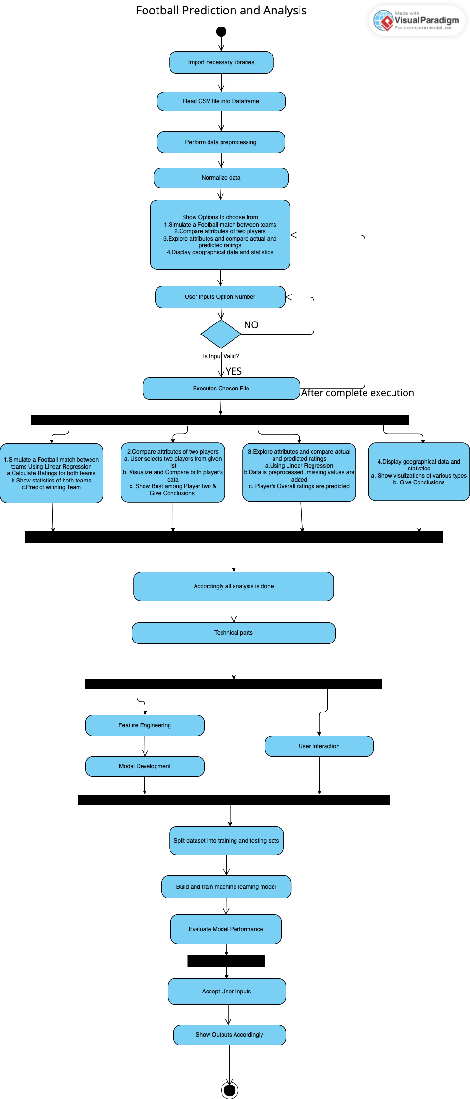

Slide 12
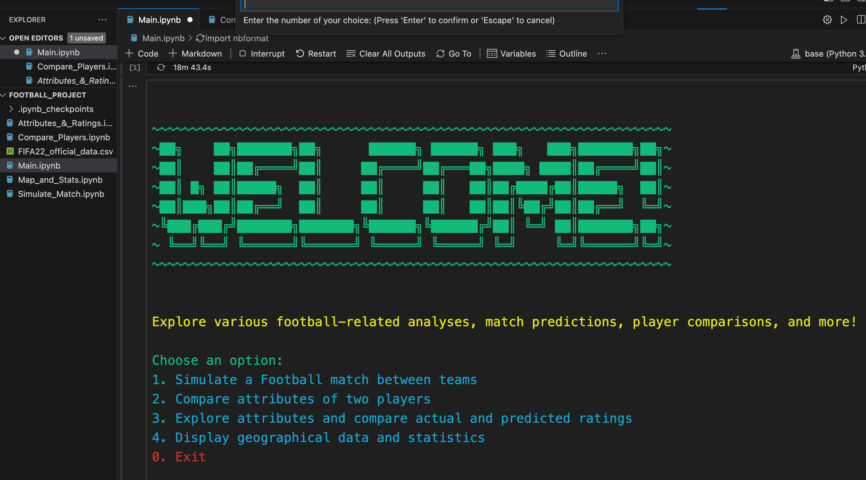

Slide 13

Thank You

